Slide 1
EXCEPTION HANDLING

Slide 2
EXCEPTION HANDLING
C
O
M
P
I
L
E
R
I
N
T
E
R
P
R
E
T
E
R
SOURCE CODE
OBJECT CODE

Slide 3
FILE HANDLING
FILE HANDLING IS A CONCEPT WHERE THE PHYSICAL FILES CAN BE CREATED AND GENERATED AND STORED IN VARIOUS LOCATIONS….

Slide 4
ABSTRACT CLASSES
Key Points: Abstract Class: Defined with the abstract keyword.Abstract Methods: Declared without an implementation.
Subclasses must provide implementations for these methods.Concrete Methods:
Can have normal methods with implementations.
Subclassing: Other classes can extend the abstract class and must implement its abstract methods.Cannot Instantiate:
You cannot create an object of an abstract class directly.

Slide 5
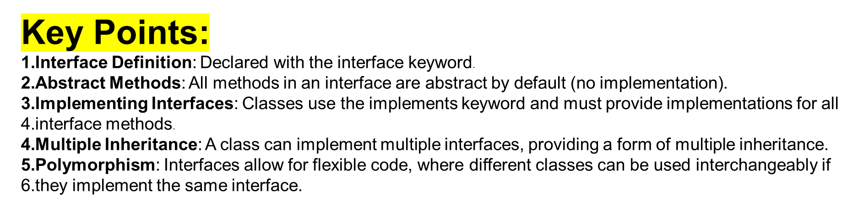
INTERFACES IN JAVA

Slide 6
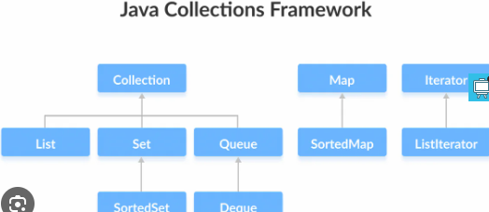
COLLECTION FRAMEWORK IN JAVA

Slide 7
WHY SO MANY OPTIONS IN COLLECTION FRAMEWORK?
Some allow duplicate / unique
Store the data in any order /specific order
Store the data in randomized way
Allow same datatypes and some will allow data of different datatypes

Slide 8
SELENIUM GRID FOR PARALLEL TESTING
What is Selenium Grid?
Selenium Grid allows you to run tests on multiple machines and browsers in parallel, speeding up test execution.
Setup Steps:
Download Selenium Server:
  Get the latest Selenium Server jar file from the official Selenium website.
Start the Hub:
  Run the following command in the terminal:
bash
java -jar selenium-server-<version>.jar hub
Start Nodes:
  On different machines or the same machine, start nodes with:
bash
java -jar selenium-server-<version>.jar node --hub http://<hub-ip>:4444
  Replace <hub-ip> with the IP address of the hub.

Slide 9
HANDLING MODALS WITH SELENIUM
Modals are pop-up dialogs that require user interaction. Here's how to handle them using Selenium:

Slide 10
AJAX CALLS
Handling AJAX calls in web automation using Selenium involves waiting for asynchronous operations to complete before interacting with elements that depend on them. Here’s how you can manage AJAX calls effectively:

Slide 11
CI TOOLS INTEGRATION- JENKINS
Setting Up Jenkins for Selenium Tests
Step 1: Install Jenkins
Download and Install Jenkins:
  Follow the installation instructions for your operating system from the Jenkins website.
Start Jenkins:
  After installation, start Jenkins by navigating to http://localhost:8080 in your web browser.
Set Up Jenkins:
  Follow the initial setup wizard to install recommended plugins and create an admin user.
Step 2: Install Plugins
Install Selenium Plugin:
  Go to Jenkins Dashboard → Manage Jenkins → Manage Plugins.
  Select the Available tab and search for "Selenium Plugin".
  Install the plugin and restart Jenkins if prompted.

Slide 12
Step 3: Configure Jenkins Job
Create a New Jenkins Job:
  Click on New Item on the Jenkins Dashboard.
  Enter a name for your job (e.g., "Selenium Tests") and select Freestyle project.
Configure Build Steps:
  Under Build, add a build step to execute your Selenium tests. This might involve running a Maven or Gradle command, executing a shell script, or using a specific build tool.
Configure Selenium Plugin:
  Add a post-build action to Publish Selenium Html Report.
  Configure the report path (usually target/surefire-reports or similar depending on your build tool).
Step 4: Set Up Selenium Grid (Optional but Recommended for Parallel Execution)
Set Up Selenium Grid:
  Configure your Selenium Grid hub and nodes as explained earlier in this session for parallel testing.

Slide 13
Update Selenium Tests:
  Modify your Selenium tests to use the Selenium Grid URL (http://<hub-ip>:4444/wd/hub) for remote WebDriver initialization.
Step 5: Run and Monitor Jenkins Job
Save and Run Jenkins Job:
  Save your Jenkins job configuration and click Build Now to run the job.
Monitor Build Execution:
  Jenkins will execute your Selenium tests according to the configured schedule or triggers.
  Check the console output for test results and any errors encountered during execution.
Benefits of Jenkins Integration:
Automation: Automatically trigger Selenium tests on code commits or scheduled intervals.
Reporting: Jenkins provides detailed build reports and integrates with plugins for enhanced reporting.
Scalability: Easily scale test execution using Jenkins' distributed builds and integration with Selenium Grid.
Continuous Feedback: Get immediate feedback on test results, enabling faster debugging and validation of changes.
By integrating Jenkins with Selenium, you can streamline your CI/CD pipeline, improve software quality, and accelerate the delivery of reliable web applications.

